Slide 1
Measures of Central Tendency (2)
Md. Ismail Hossain Riday

Slide 2
Measures of Location
We have learned that median divided a set of data into two equal parts.
In the same way, we can divides a set of data into
Four equal parts
Ten equal parts
Hundred equal parts
Quartiles
Deciles
Percentiles

Slide 3
Q, D, and P
Quartiles: Divide the data set into four equal parts. So, we get 3 quartile points: Q1, Q2, and Q3
Deciles: Divide the data set into ten equal parts. So, we get 9 decile points: D1, D2, D3, … , D9.
Percentiles: Divide the data set into hundred equal parts. So, we get 99 percentile points: P1, P2, P3, … , P99

Slide 4
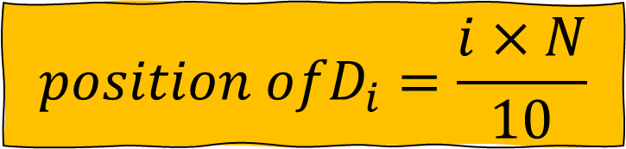
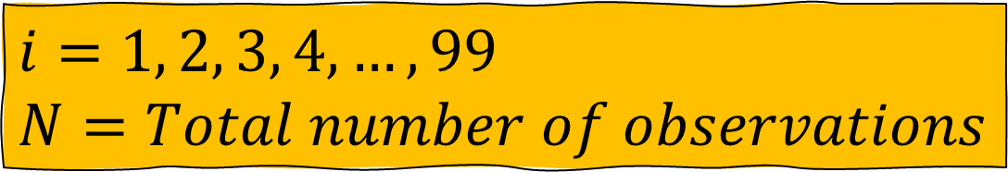
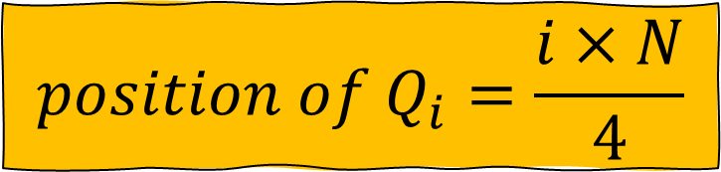
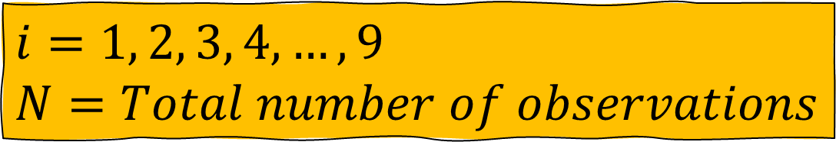
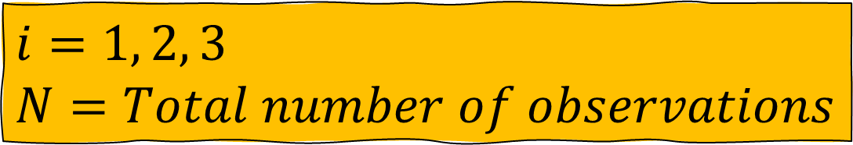
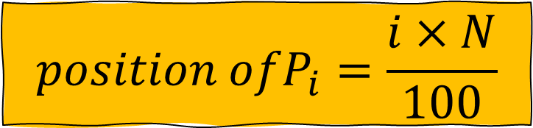
Q, D, and P (Ungrouped)
$$position of Q_{i}=\frac{i×N}{4}$$
$i=1, 2, 3$
$N=Total number of observations$
$${position ofD}_{i}=\frac{i×N}{10}$$
$i=1, 2, 3, 4, …,9$
$N=Total number of observations$
$${position ofP}_{i}=\frac{i×N}{100}$$
$i=1, 2, 3, 4, …,99$
$N=Total number of observations$

Slide 5
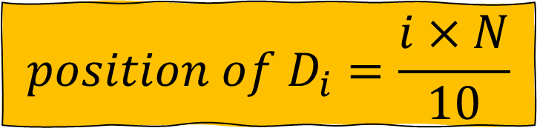
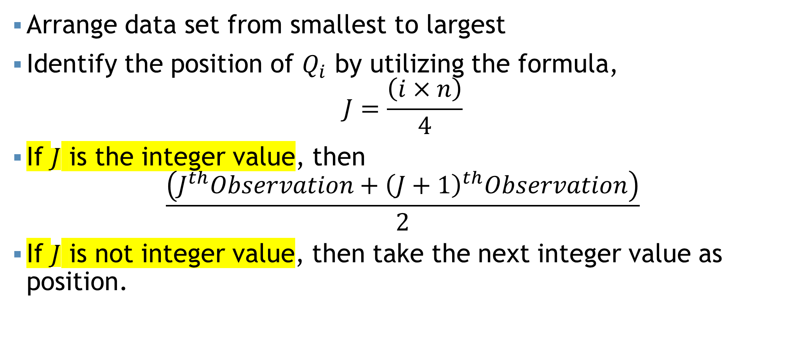
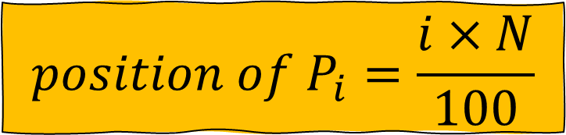
Steps…
$$position of D_{i}=\frac{i×N}{10}$$
$$position of P_{i}=\frac{i×N}{100}$$
Arrange data set from smallest to largest
Identify the position of $Q_{i}$ by utilizing the formula,
$$J=\frac{\left(i×n\right)}{4}$$
If $J$ is the integer value, then
$$\frac{\left(J^{th}Observation+{\left(J+1\right)}^{th}Observation\right)}{2}$$
If $J$ is not integer value, then take the next integer value as position.

Slide 6
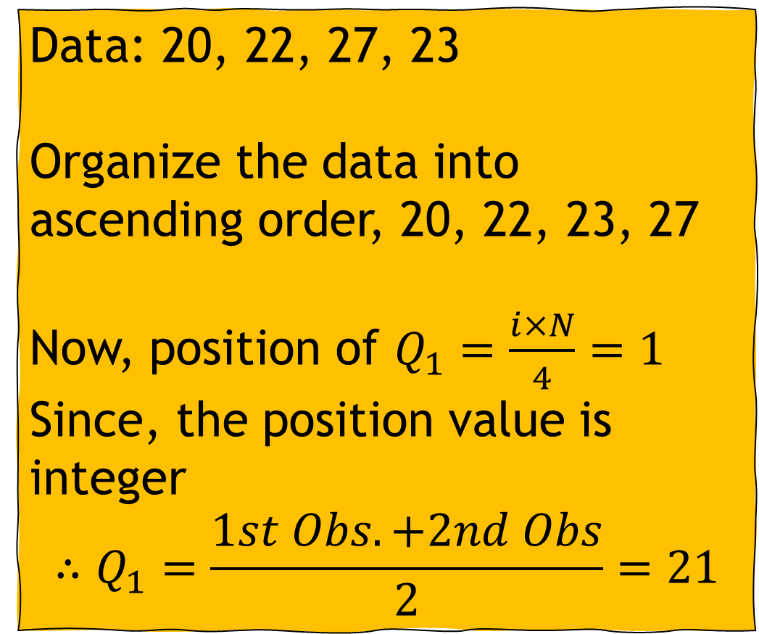
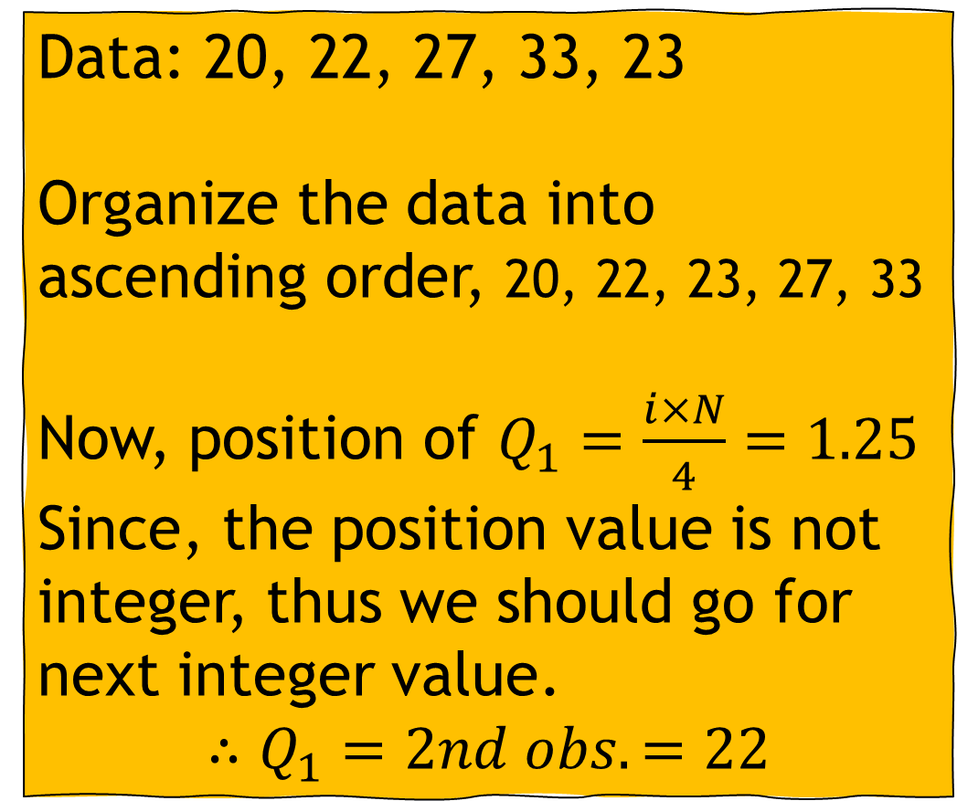
Example (Ungrouped)
Data: 20, 22, 27, 33, 23
Organize the data into ascending order, 20, 22, 23, 27, 33
Now, position of $Q_{1}=\frac{i×N}{4}=1.25$
Since, the position value is not integer, thus we should go for next integer value.
$$∴Q_{1}=2nd obs.=22$$
Data: 20, 22, 27, 23
Organize the data into ascending order, 20, 22, 23, 27
Now, position of $Q_{1}=\frac{i×N}{4}=1$
Since, the position value is integer
$$∴Q_{1}=\frac{1st Obs. +2nd Obs}{2}=21$$

Slide 7
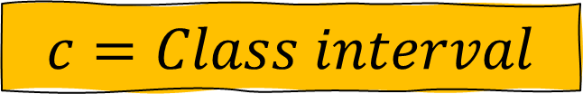
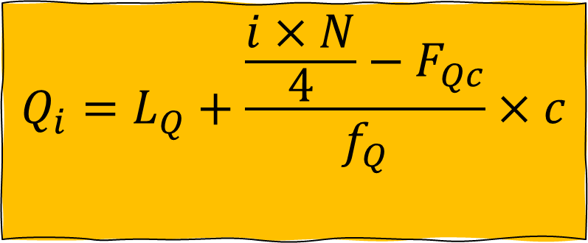
Q, D, and P (Grouped)
$$Q_{i}=L_{Q}+\frac{\frac{i×N}{4}−F_{Qc}}{f_{Q}}×c$$
$$L_{Q}=Lower limit of quartile class$$
$$N=Total number of observations$$
$$F_{c}=Cumultative frequency of pre−quartile class$$
$$f_{Q}=Frequency of quartile class$$
$$c=Class interval$$

Slide 8
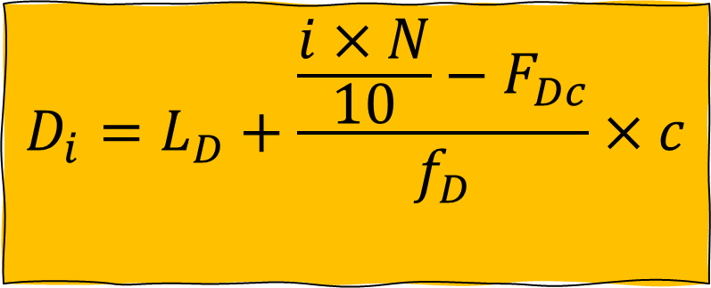
Q, D, and P (Grouped)
$$D_{i}=L_{D}+\frac{\frac{i×N}{10}−F_{Dc}}{f_{D}}×c$$
$$L_{D}=Lower limit of decile class$$
$$N=Total number of observations$$
$$F_{c}=Cumultative frequency of pre−decile class$$
$$f_{D}=Frequency of decile class$$
$$c=Class interval$$

Slide 9
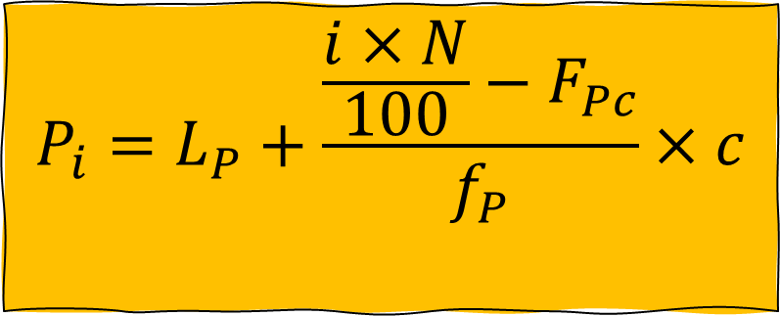
Q, D, and P (Grouped)
$$P_{i}=L_{P}+\frac{\frac{i×N}{100}−F_{Pc}}{f_{P}}×c$$
$$L_{P}=Lower limit of percentile class$$
$$N=Total number of observations$$
$$F_{c}=Cumultative frequency of pre−percentile class$$
$$f_{P}=Frequency of percentile class$$
$$c=Class interval$$

Slide 10

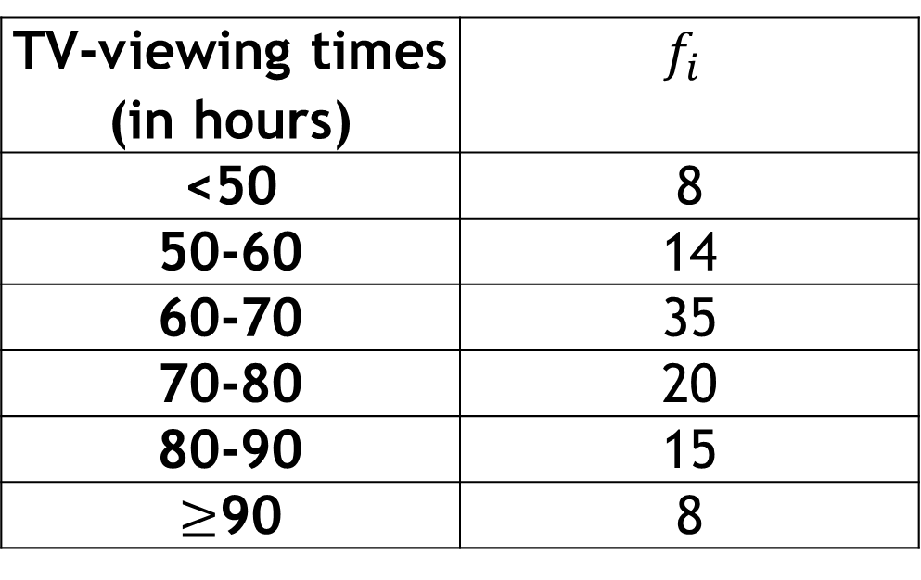
Self Practice!!!
$$\text{Determine} Q_{1}, Q_{2}, and Q_{3} \text{with} \text{interpretation}\text{.}$$
A social organization publishes information on the TV-viewing habits of Bangladeshi garments workers in a report on Television. A sample of 100 garments workers yielded the monthly viewing times, in hours, displayed on the table,
Ans: 60.9, 68, and 79
TV-viewing times (in hours) | $$f_{i}$$
<50 | 8
50-60 | 14
60-70 | 35
70-80 | 20
80-90 | 15
$≥$90 | 8

Slide 11
Self Practice!!!
a. Construct a table and calculate frequency from this ogive curve.
b. Using table from (a), calculate the mean, median, mode.

Slide 12
Mathematical exercise
To access additional mathematical problems, please refer to the PDF lecture notes and Books.

Slide 13
Thank You

